Slide 1



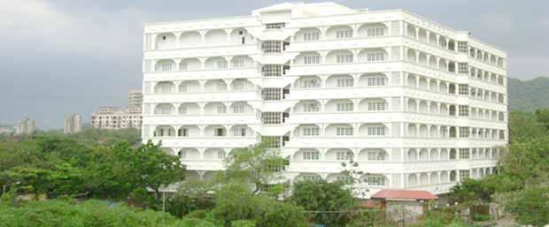

Mahavir Education Trust’s
Shah & Anchor Kutchhi Engineering College
Chembur, Mumbai-400088
An Autonomous Institute Affiliated to University of Mumbai

Slide 2


Design, Analyze and Demonstrate a Practical WAN Solution for Banking
Presented By
Name- Srushti Badgujar
Roll Number- 05
Class-SY

Slide 3


Problem Statement
Engineering Challenge
Modern banks require
Secure communication between branches
Fast transaction processing
High network availability
Protection against cyber attacks
Scalable infrastructure for future expansion
Existing Problems
Slow WAN links
Data interception risks
Single point of failure
High downtime
Limited scalability
2

Slide 4


Objectives
Project Objectives
Design a WAN that provides
Secure communication between branches
Reliable connectivity
Fast transaction processing
Centralized banking database access
Easy scalability
High availability
Secure customer information
3

Slide 5

Proposed WAN Architecture
Network Design
Include Draw.io or Packet Tracer Diagram
Network Design
Include Draw.io or Packet Tracer Diagram
Components
Head Office
Branch Office 1
Branch Office 2
ISP Cloud
Core Router
Branch Routers
Layer-2 Switches
PCs
Banking Server
DNS Server
Web Server
5

Slide 6
Proposed WAN Architecture
Network Design
Include Draw.io or Packet Tracer Diagram
Technologies Used
IP Addressing
Static Routing / OSPF
DHCP
Access Control Lists (ACLs)
Network Address Translation (NAT)
VPN (Concept)
Benefits
Centralized management
Secure communication
Reliable connectivity
Easy maintenance
5

Slide 7
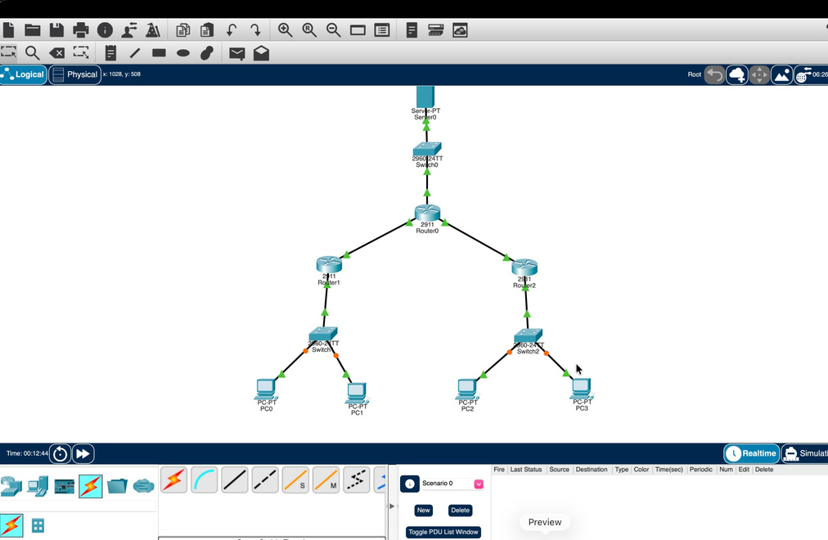
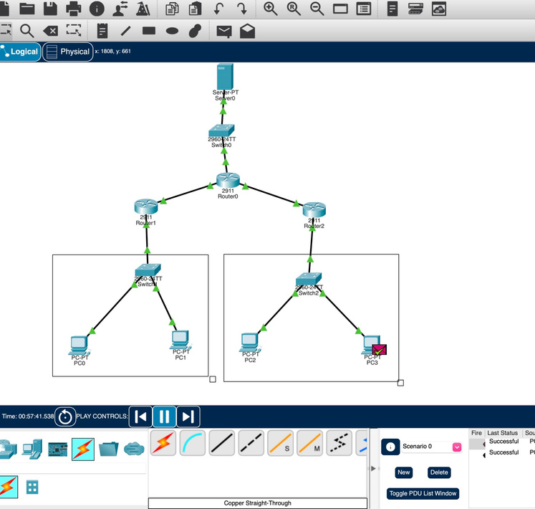
Practical Implementation
Cisco Packet Tracer Demonstration
Configuration Performed
Configured routers and switches
Assigned IP addresses
Configured routing
Enabled DHCP
Tested connectivity using Ping
Connected all branches to the head office
Verification
Successful communication between branches
Server accessible from all locations
No packet loss during testing
Video Link: https://youtu.be/zMLtAR2WwXE
2

Slide 8
Network Traffic Analysis
Wireshark Packet Analysis
Wireshark was used to observe network communication and verify successful packet transmission.
Captured Protocols
ARP
ICMP
DNS
TCP
HTTP
Analysis
ARP resolved MAC addresses.
ICMP confirmed connectivity.
DNS resolved server names.
TCP ensured reliable communication.
HTTP demonstrated successful access to banking services.
2

Slide 9
Performance Analysis
Performance Evaluation
Parameters Evaluated:
Parameter Result
Connectivity Excellent
Latency Low
Packet Loss Minimal
Throughput High
Reliability High
Observations
Stable communication between branches
Fast response time
Efficient packet delivery
Continuous banking services
2

Slide 10
Security Features
Network Security
Security measures implemented include:
VPN for secure branch communication
Access Control Lists (ACLs)
Router authentication
Password-protected devices
Firewall (conceptual)
Network segmentation
Advantages
Protects customer information
Prevents unauthorized access
Secures online transactions
Improves overall network security
2

Slide 11
SDG 8
Supporting Sustainable Development Goal 8
The proposed WAN solution contributes to SDG 8 – Decent Work and Economic Growth by:
Enabling reliable digital banking infrastructure
Supporting secure online financial services
Reducing operational downtime
Improving customer satisfaction
Supporting business expansion
Creating opportunities for digital employment
2

Slide 12
Conclusion
Conclusion
The proposed WAN solution successfully addresses the networking requirements of modern banking by providing:
Secure communication
Reliable branch connectivity
High network availability
Improved performance
Scalability for future expansion
Enhanced security for financial transactions
Key Outcome
This solution demonstrates how a well-designed WAN can improve banking operations while supporting secure, efficient, and sustainable digital infrastructure aligned with SDG 8.
2

Slide 13

Thank you
for listening
For Presentation
2022 May 15
All-Purpose
Full Name

